Slide 1
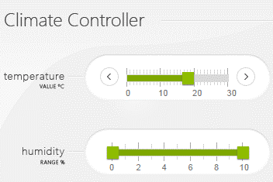
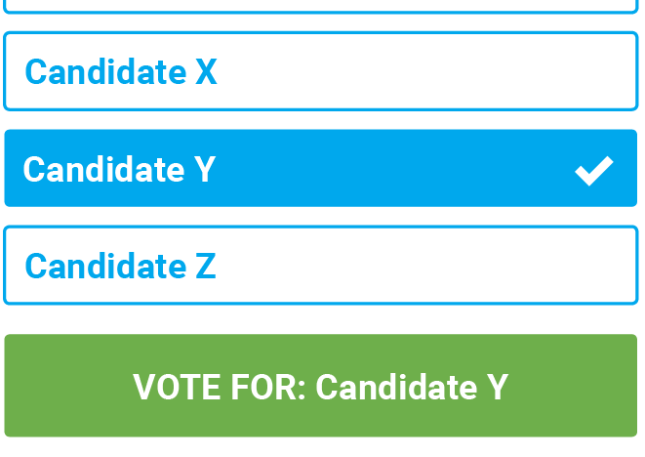

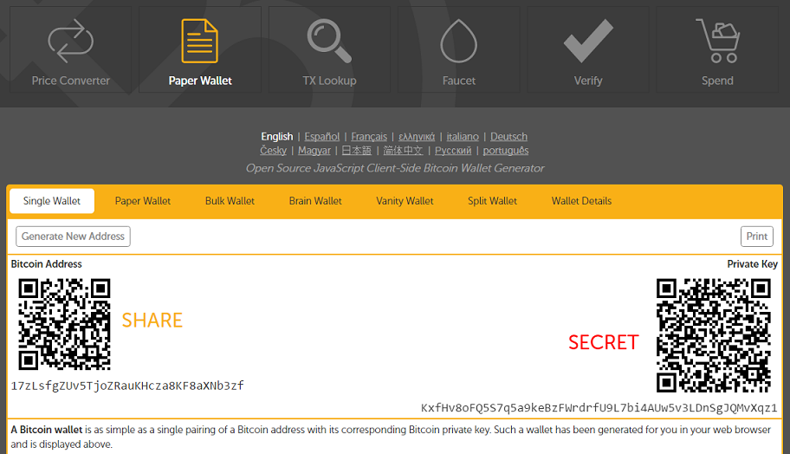
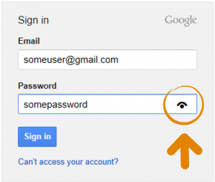
1) Safety-critical systems
2) E-voting
3) Bitcoin wallet
4) Web credential

Slide 2








1
TEE
2
IO driver
User
HIDs
Host
Remote server

Slide 3

1
TEE
2
IO driver
User
HIDs
Host
Remote server

Slide 4





Server
Application level payload
IO second factor
Network
Frames
Input forward
Input
Bridge
Overlay
Host
IO signals

Slide 5
Server
Application level payload
IO second factor
Network
Frames
Input forward
Host
Input
IOHub
Overlay
IO signals

Slide 6





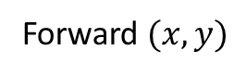
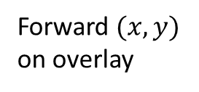
9
Verify
Remote server
7
HTTP data
8
Overlay action
1
Browser render
3
Decode + Overlay
Frame + overlay UI
Send frame
4
2
Forward $(x,y)$
6
Forward $(x,y)$
on overlay
6
Host
Bridge
Display
5
Input

Slide 7

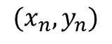
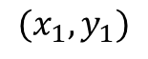
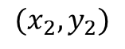
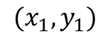
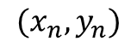
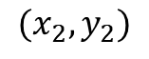
$$(x_{1},y_{1})$$
$$(x_{1},y_{1})$$
$$(x_{2},y_{2})$$
$$(x_{2},y_{2})$$
$$(x_{n},y_{n})$$
$$(x_{n},y_{n})$$
Device side mouse trace
Incoming frames + mouse detection

Slide 8
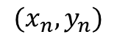
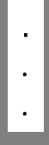
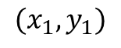
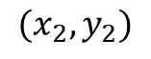
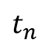

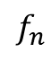
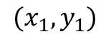
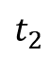
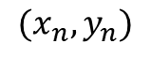
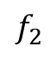
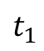
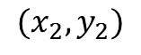
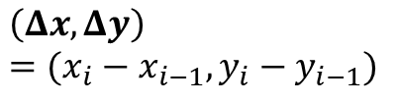
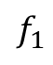
$$t_{1}$$
$$(x_{1},y_{1})$$
$$f_{1}$$
$$(x_{1},y_{1})$$
$$\left(Δx, Δy\right)=(x_{i}−x_{i−1}, y_{i}−y_{i−1})$$
$$t_{2}$$
$$(x_{2},y_{2})$$
$$f_{2}$$
$$(x_{2},y_{2})$$
$$.$$
.
.
$$.$$
.
.
$$t_{n}$$
$$f_{n}$$
$$(x_{n},y_{n})$$
$$(x_{n},y_{n})$$
OK
Click
Click
1
IOHub side mouse trace
2
Incoming frames + mouse detection

Slide 9
Sensitive form
Sensitive field 1
Sensitive field 2
OK
Cancel

Slide 10
Sensitive form
Sensitive field 1
Sensitive field 2
Mouse pointer
UI snapshot
OK
Cancel

Slide 11
Sensitive form
Sensitive form
0
100
0
100
Slider
35
Slider
35
Mouse pointer
UI
UI
Extracted value
Mouse pointer
OK
Cancel
OK
Cancel
1
2

Slide 12
Sensitive form
Sensitive form
0
100
0
100
Slider
35
Slider
35
Mouse pointer
UI snapshot
UI snapshot
Extracted value
Mouse pointer
OK
Cancel
OK
Cancel
1
2

Slide 13
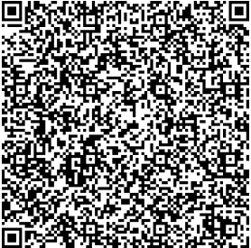
Sensitive form
Sensitive form
Sensitive form
1
2
3
Sensitive field 1
Verified UI from secure_site.io
Sensitive field 1
Data_1
Sensitive field 2
QR code generation
Overlay
Sensitive field 2
Data_2
OK
Cancel
OK
Cancel
Integrity protected
Normal field
Normal field
Normal field
<form action="/some_action“, signature = “0x45AB…”, id = “0x0ab”>
Sensitive field 1: <input type="text" name=“tb_1” protect=“true”><br>
Sensitive field 2: <input type="text" name=“tb_2” protect=“true”><br>
<button type="submit" value="Submit” protect=“true”>Submit</button> <button type="reset" value="Reset” protect=“true”>Reset</button>
Normal field: <input type="text" name=“textbox_3"><br>
</form>
Data to the browser
5
Sensitive field 1:Data_1
Sensitive field 2:Data_2
Action:OK
Sign(payload)
4
Payload

Slide 14

Host
Device
Display
Server
Mouse trace
Frames
Verify
Mouse
Frame + overlay
HTTP request
response
Frames
Frame + overlay
Record inputs + update overlay
Form
Submit data
Send data

Slide 15
Host
IOHub
Display
Server
Mouse trace
Frames
Verify
Mouse
Frame + overlay
HTTP request
response
Frames
Frame + overlay
Form
Record inputs + update overlay
Submit data
Send data

Slide 16
Send encrypted input
2
Encrypt
3
Frame + input overlay
4
ABC
4
Frame
Host
Device
Display
1
Input

Slide 17
Server
1
Webpage + encrypted data
3
Decrypt
2
Frame
Frame + overlay
4
ABC
Host
Device
Display

Slide 18
Text box 1
Text box 2
Option 1
Option 2
Oblivious window
OK
Cancel
Render at host’s side
Server side static image
Text box 1
Text box 2
HTML + overlay on device
Option 1
Option 2
OK
Cancel

Slide 19
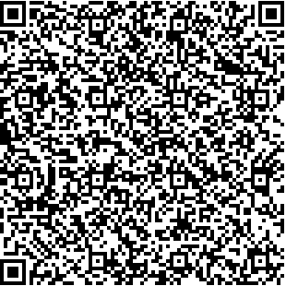
Pointer information to the host
1
Text box 1
Verified UI from secure_site.io
Option 1
Text box 2
Option 2
OK
Cancel
QR code with encrypted UI specification
2
Decoded and Decrypted UI
Render at host’s side + disabled pointer
3
Text box 1
rendered pointer overlaid by the IOHub
Static pointer
Text box 2
Verified UI from secure_site.io
Option 1
Option 2
OK
Cancel
Overlay
HTML + overlay on IOHub + rendered pointer

Slide 20
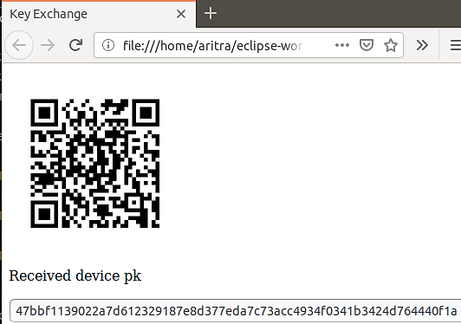
Remote server’s certificate
(Downstream channel)
1
2
IOHub
Certificate of the IOHub
(Upstream channel)
3
4

Slide 21
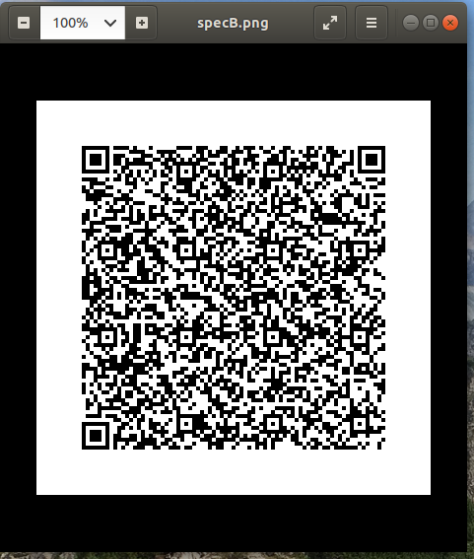
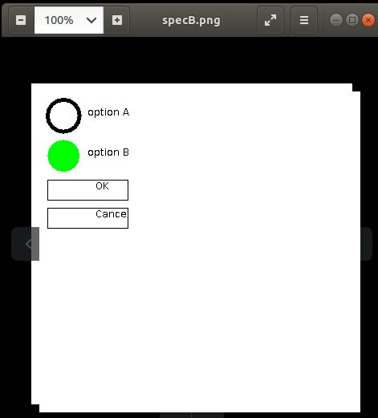
Render at host’s side
HDMI frames + overlay

Slide 22
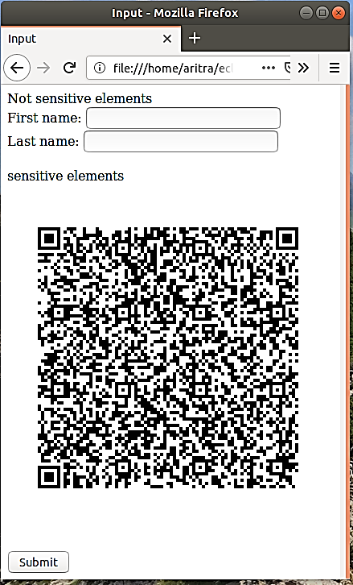
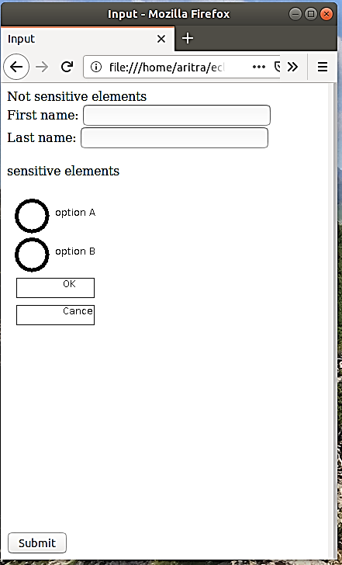
1
2
Host’s view
User’s view on the monitor

Slide 23
1
2
Host’s view
User’s view on the monitor

Slide 24
a
b
c
Attacker’s view
User’s view on the monitor
Focusing user’s attention

Slide 25
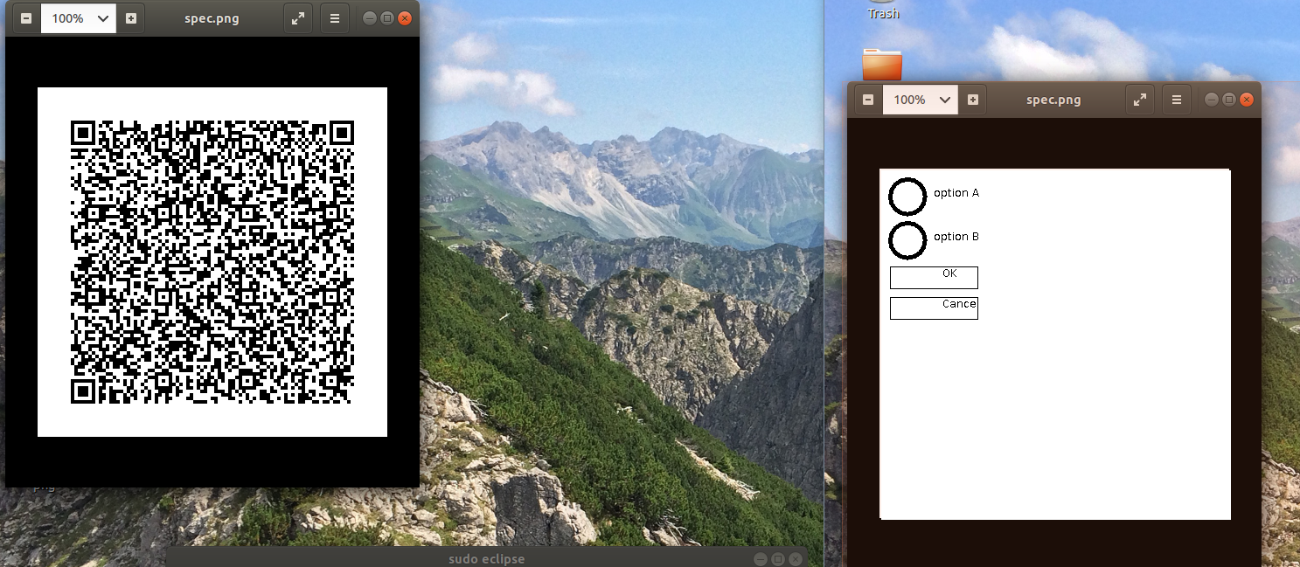
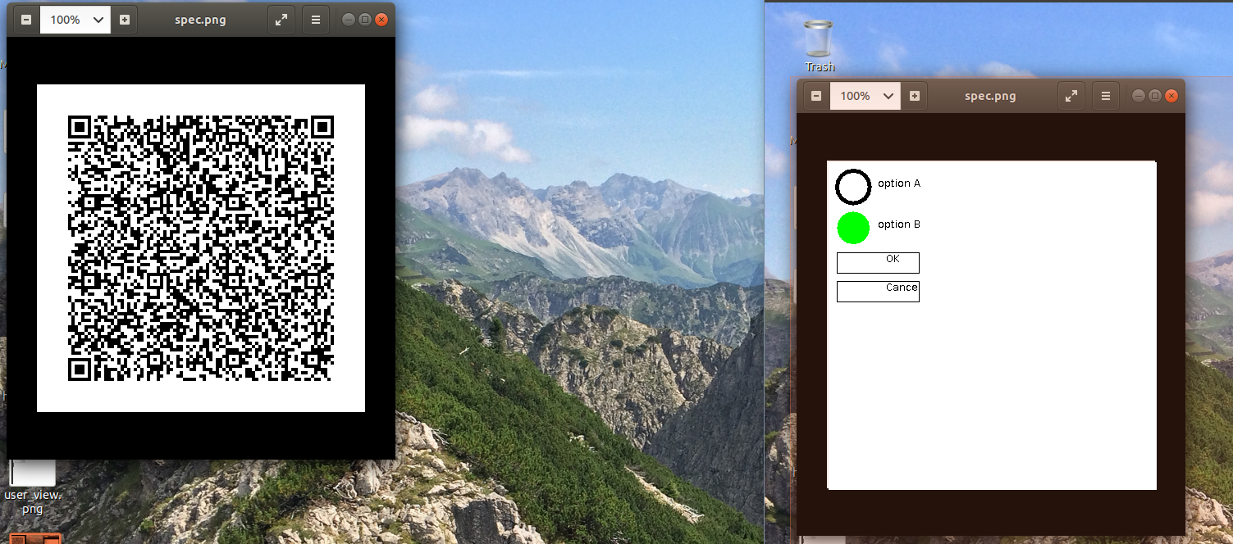
Render at host’s side
HDMI frames + overlay
1
Render at host’s side
Interaction on overlay
2

Slide 26
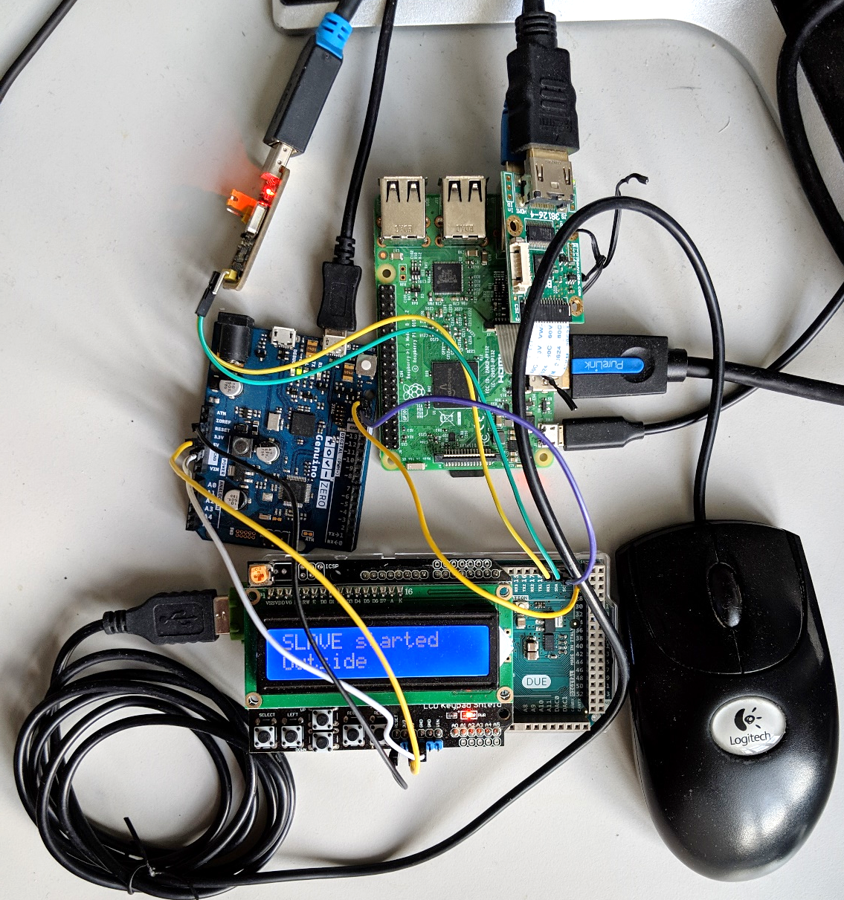
HDMI from host
HDMI to camera input

Slide 27
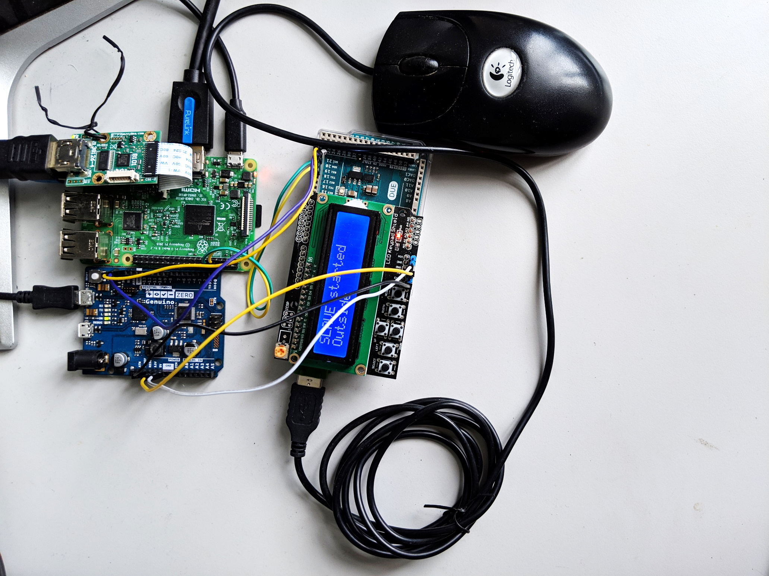
Rpi 3 for communication to host
HDMI from host
HDMI to camera input
Mouse/keyboard emulator
Mouse/keyboard interceptor and relay
HDMI to Display

Slide 28
5
8
4
6
7
9
2
3
1

Slide 29
1
9
7
3
8
6
5
4
2

Slide 30
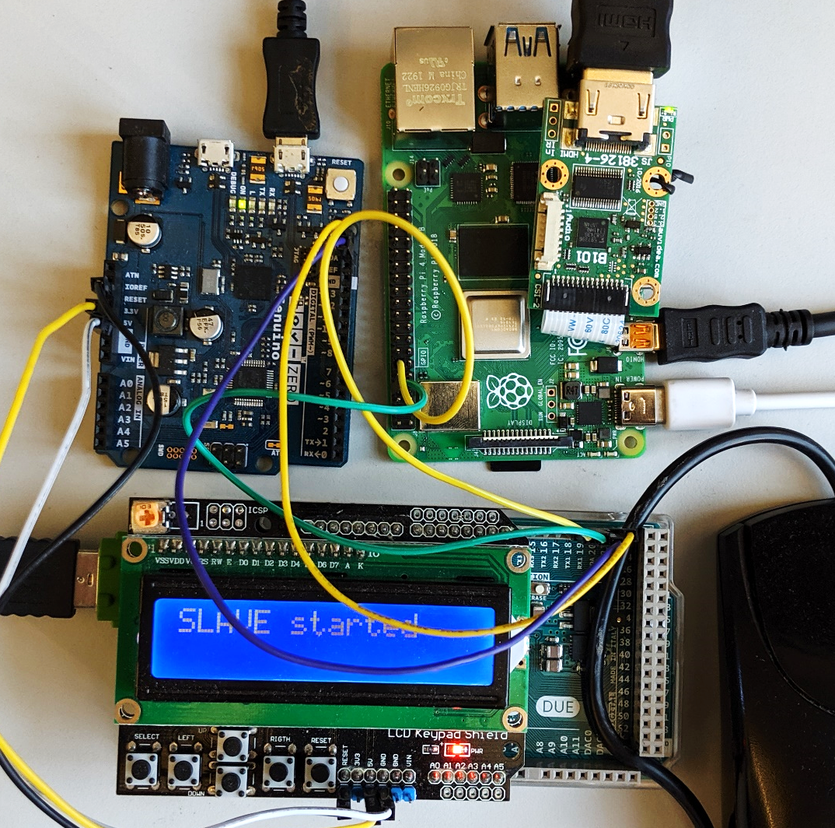
5
6
8
4
7
9
3
1
2
Notes:
Pi4

Slide 31
7
HDMI interceptor
HDMI out
8
Device
6
Raspberry pi 3
Host
9
Display
4
3
1
Arduino
Zero
Arduino
Due
Input device
USB in
5
2

Slide 32
Device
7
Raspberry pi 4
HDMI out
HDMI interceptor
6
Display
8
9
4
3
1
Arduino
Zero
Arduino
Due
Input device
USB in
5
2

Slide 33
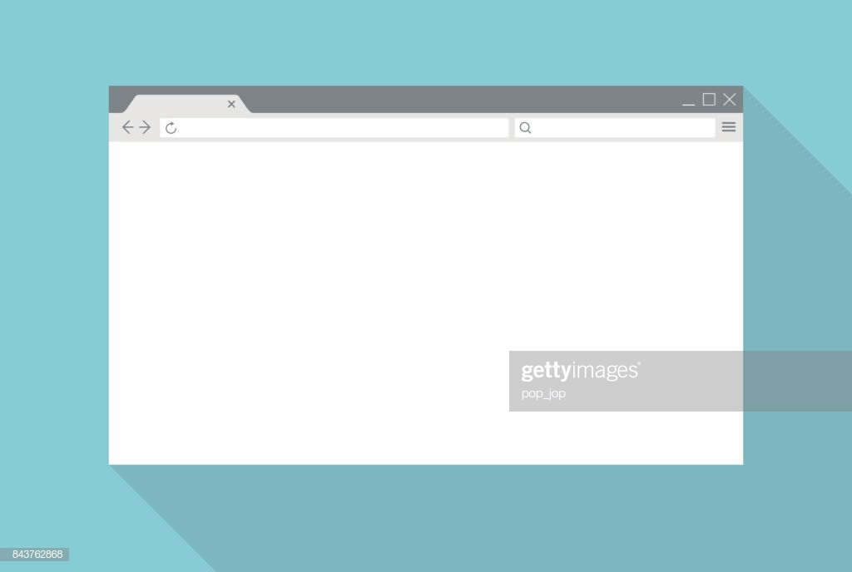
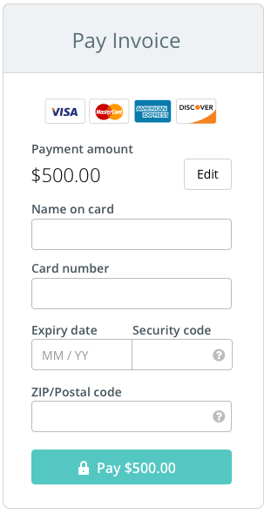
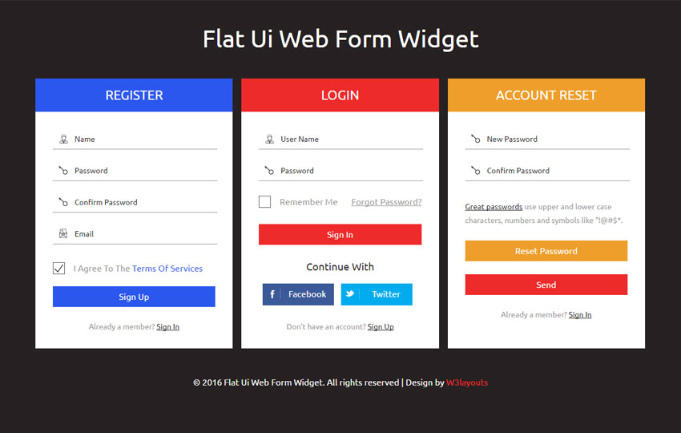
Early form submission
Jon Snow
Overlaid textfields
1111 1111 1111 1111
12/21
123
Fake cursor that user follows
1234
Real cursor

Slide 34
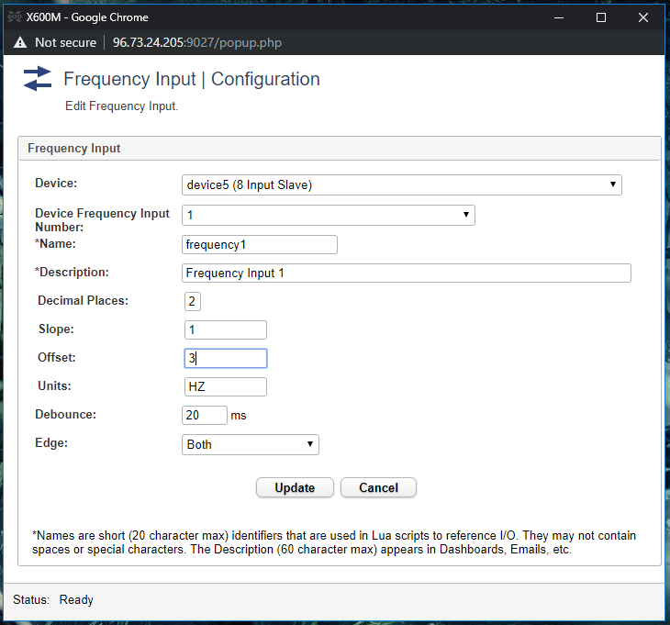
Textbox in focus
OS triggers click

Slide 35
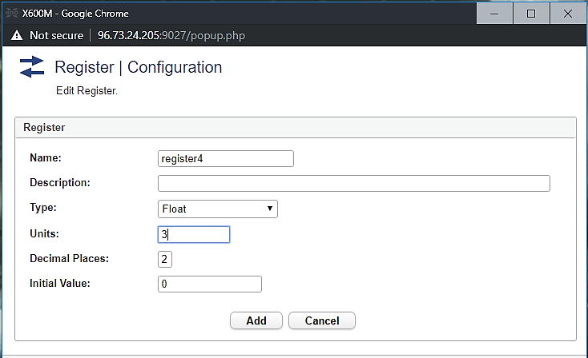
Textbox in focus
OS triggers click

Slide 36
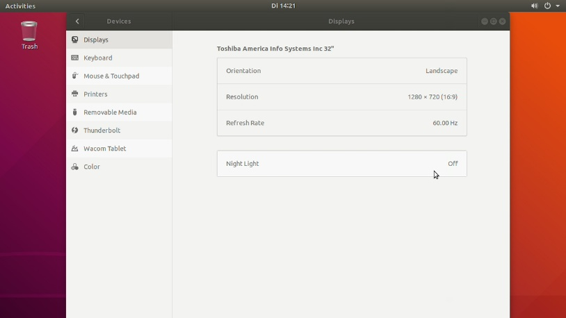
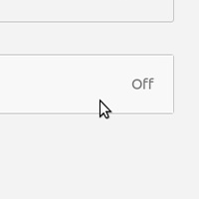
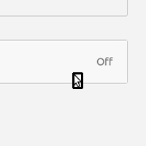
1
2
3
4
Cursor template
HDMI frame
Cropped frame
Detected cursor

